Slide 1

What are Arrays in Java and how to Implement them?
Created and Published By : - Girish Rathode

Slide 2
Java Arrays
An array is a collection of similar types of data.
It is a container that holds data (values) of one single type.
For example, you can create an array that can hold 100 values of int type.
In Java, arrays are a fundamental construct that allows you to store and access a large number of values conventienty.

Slide 3
How to declare an array?
In Java, here is how we can declare an array.
dataType[ ] arrayName;
dataType - it can be primitive data types like int, char, double, byte, etc. or Java objects
arrayName - it is an identifier

Slide 4
Let's take an example,
double[] data;
Here, data is an array that can hold values of type double.

Slide 5
But, how many elements can array this hold?
We have to allocate memory for the array.
The memory will define the number of elements that the array can hold.
data = new Double[10];
Here, the size of the array is 10.
This means it can hold 10 elements (10 double types values).
The size of an array is also known as the length of an array.

Slide 6
Note: Once the length of the array is defined, it cannot be changed in the program.
Let's take another example:
int[] age; age = new int[5];
Here, age is an array. It can hold 5 values of int type.
In Java, we can declare and allocate memory of an array in one single statement. For example,
int[] age = new int[5];

Slide 7
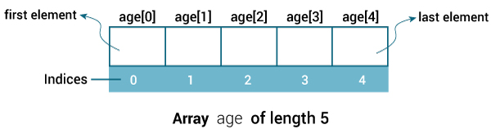
Java Array Index
In Java, each element in an array are associated with a number.
The number is known as an array index.
We can access elements of an array by using those indices. For example,
int[] age = new int[5];

Slide 8
If we did not store any value to an array, the array will store some default value (0 for int type and false for boolean type) by itself. For example,
class ArrayExample {
public static void main(String[] args) {
// create an array of length 5
int[] age = new int[5];
// access each element of the array using the index number
System.out.println(age[0]);
System.out.println(age[1]);
System.out.println(age[2]);
System.out.println(age[3]);
System.out.println(age[4]);
}
}

Slide 9
Here, we are individually accessing the elements of the array. There is a better way to access elements of the array using a loop (generally for-loop). For example,
class ArrayExample {
public static void main(String[] args) {
// create an array of length 5
int[] age = new int[5];
// accessing elements using for loop
for (int i = 0; i < 5; ++i) {
System.out.println(age[i]);
}
}
}

Slide 10
Multidimensional Arrays
Arrays we have mentioned till now are called one-dimensional arrays. However, we can declare multidimensional arrays in Java.
A multidimensional array is an array of arrays. That is, each element of a multidimensional array is an array itself. For example,
int[][] a = new int[3][4];

Slide 11
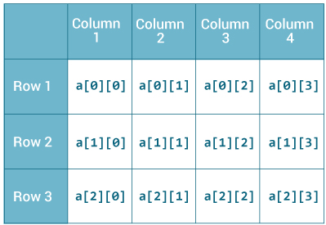
Multidimensional Arrays
Here, we have created a multidimensional array named a.
It is a 2-dimensional array, that can hold a maximum of 12 elements,

Slide 12
Remember, Java uses zero-based indexing, that is, indexing of arrays in Java starts with 0 and not 1.
Let's take another example of the multidimensional array.
This time we will be creating a 3-dimensional array.
For example,
String[][][] data = new String[3][4][2];
Here, data is a 3d array that can hold a maximum of 24 (3*4*2) elements of type String.

Slide 13
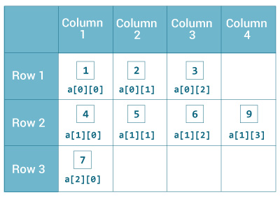
How to initialize a 2d array in Java?
Here is how we can initialize a 2-dimensional array in Java.
int[][] a = {
{1, 2, 3}, {4, 5, 6, 9}, {7},
};

Slide 14
Example: 2-dimensional Array
class MultidimensionalArray {
public static void main(String[] args) {
// create a 2d array
int[][] a = {
{1, 2, 3},
{4, 5, 6, 9},
{7},
};
// calculate the length of each row
System.out.println("Length of row 1: " + a[0].length);
System.out.println("Length of row 2: " + a[1].length);
System.out.println("Length of row 3: " + a[2].length);
}
}

Slide 15
Example: Print all elements of 2d array Using Loop
class MultidimensionalArray {
public static void main(String[] args) {
int[][] a = {
{1, -2, 3},
{-4, -5, 6, 9},
{7},
};
for (int i = 0; i < a.length; ++i) {
for(int j = 0; j < a[i].length; ++j) {
System.out.println(a[i][j]);
}
}
}
}

Slide 16
Java Copy Arrays
//1. Copying Arrays Using Assignment Operator
class Main {
public static void main(String[] args) {
int [] numbers = {1, 2, 3, 4, 5, 6};
int [] positiveNumbers = numbers; // copying arrays
for (int number: positiveNumbers) {
System.out.print(number + ", ");
}
}
}

Slide 17
//Copying Arrays Using arraycopy() method
// To use Arrays.toString() method
import java.util.Arrays;
class Main {
public static void main(String[] args) {
int[] n1 = {2, 3, 12, 4, 12, -2};
int[] n3 = new int[5];
// Creating n2 array of having length of n1 array
int[] n2 = new int[n1.length];
// copying entire n1 array to n2
System.arraycopy(n1, 0, n2, 0, n1.length);
System.out.println("n2 = " + Arrays.toString(n2));
// copying elements from index 2 on n1 array
// copying element to index 1 of n3 array
// 2 elements will be copied
System.arraycopy(n1, 2, n3, 1, 2);
System.out.println("n3 = " + Arrays.toString(n3));
}
}

Slide 18
//Copying Arrays Using copyOfRange() method
// To use toString() and copyOfRange() method
import java.util.Arrays;
class ArraysCopy {
public static void main(String[] args) {
int[] source = {2, 3, 12, 4, 12, -2};
// copying entire source array to destination
int[] destination1 = Arrays.copyOfRange(source, 0, source.length);
System.out.println("destination1 = " + Arrays.toString(destination1));
// copying from index 2 to 5 (5 is not included)
int[] destination2 = Arrays.copyOfRange(source, 2, 5);
System.out.println("destination2 = " + Arrays.toString(destination2));
}
}

